Slide 1


SAP UI5 & FIORI
Models & Data Binding
www.zarantech.com
© Copyright 2021, ZaranTech LLC. All rights reserved.

Slide 2

Disclaimer
2
This presentation, including examples, images, and references are provided for informational purposes only.
Complying with all applicable copyrights laws is the responsibility of the user.
Without limiting the rights under copyright, no part of this document may be reproduced, stored or introduced into a retrieval system, or transmitted in any form or by any means.
Credits shall be given to the images taken from the open-source and cannot be used for promotional activities.
© Copyright 2021, ZaranTech LLC. All rights reserved.

Slide 3
Agenda
3
Data Binding – Getting Started
Models and Data Binding in Applications
Binding Types
Using the Data Binding Type System
Calculated Fields for Data Binding
Using Data Binding for Data Export
Property Metadata Binding

Slide 4
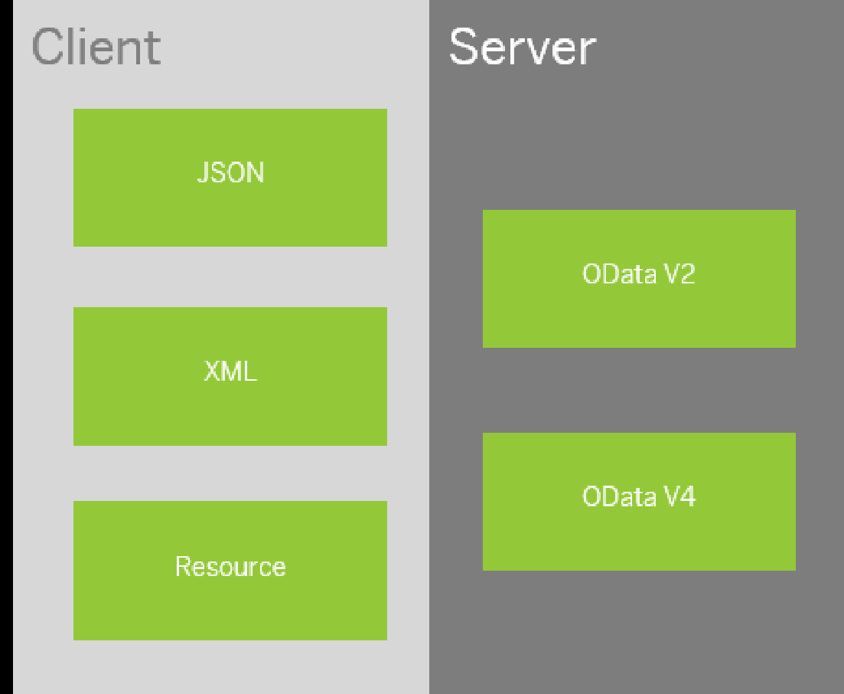
Models & Data Binding
2
Models - Overview
A model in the Model View Controller concept holds the data and provides methods to retrieve the data from the database and to set and update data.
‹#›
© Copyright 2021, ZaranTech LLC. All rights reserved.

Slide 5
Models & Data Binding
2
Models - Predefined
A model in the Model View Controller concept holds the data and provides methods to retrieve the data from the database and to set and update data.
Predefined Models
OData Model
JSON Model
XML Model
Resource Model
‹#›
© Copyright 2021, ZaranTech LLC. All rights reserved.

Slide 6
Models & Data Binding
2
Models - OData
Enables binding of controls to data from OData services. The OData model supports two-way, one-way and one-time binding modes. However, two-way binding is currently only supported for properties, and not for aggregations.
OData V2
OData V4 (limited feature scope)
‹#›
© Copyright 2021, ZaranTech LLC. All rights reserved.

Slide 7
Models & Data Binding
2
Models - JSON
Can be used to bind controls to JavaScript object data, which is serialized in the JSON format.
The JSON model is a client-side model and, therefore, intended for small data sets, which are completely available on the client.
The JSON model supports two-way (default), one-way and one-time binding modes.
‹#›
© Copyright 2021, ZaranTech LLC. All rights reserved.

Slide 8
Models & Data Binding
2
Models - XML
A client-side model intended for small data sets, which are completely available on the client.
The XML model does not contain mechanisms for server-based paging or loading of deltas.
The XML model supports two-way (default), one-way and one-time binding modes.
Resource Model
Designed to handle data in resource bundles, mainly to provide texts in different languages.
The resource model only supports one-time binding mode because it deals with static texts only.
‹#›
© Copyright 2021, ZaranTech LLC. All rights reserved.

Slide 9
Models & Data Binding
2
Data Binding
Data binding is used to bind two data or information sources together to keep them in sync.
If this is implemented and defined properly, all changes in one data source are automatically reflected in the other data source.
UI uses data binding to bind UI controls to a data source that holds the application data.
‹#›
© Copyright 2021, ZaranTech LLC. All rights reserved.

Slide 10
Models & Data Binding
2
Data Binding - Types
Data Binding Types
One-time
One-way
Two-way
‹#›
© Copyright 2021, ZaranTech LLC. All rights reserved.

Slide 11
Models & Data Binding
2
Data Binding - Types
The binding mode defines how the data sources are bound. SAPUI5 provides the following binding modes:
One-way binding means a binding from the model to the view; value changes in the model update all corresponding bindings and the view
Two-way binding means a binding from the model to the view and from the view to the model, changes in the model and in the view fire events that automatically trigger updates all corresponding bindings and the view and model
One-time binding means from model to view once.
‹#›
© Copyright 2021, ZaranTech LLC. All rights reserved.

Slide 12
Models & Data Binding
2
Steps for Data Binding in your Application
Decide the Model
Create the Model Instance
Create the Control Instance
Bind properties or lists of the control to your model.
Unbind properties
‹#›
© Copyright 2021, ZaranTech LLC. All rights reserved.

Slide 13

Models & Data Binding
2
Lets see, How to define the data?
‹#›
© Copyright 2021, ZaranTech LLC. All rights reserved.

Slide 14
Models & Data Binding
2
Lets see, How to create Data Binding Model Instance?
‹#›
© Copyright 2021, ZaranTech LLC. All rights reserved.

Slide 15
Models & Data Binding
2
Lets see, How to create Controls & Property Binding?
‹#›
© Copyright 2021, ZaranTech LLC. All rights reserved.

Slide 16
Models & Data Binding
2
Lets see, How to build UI?
‹#›
© Copyright 2021, ZaranTech LLC. All rights reserved.

Slide 17
Models & Data Binding
2
Lets see, How to build UI?
‹#›
© Copyright 2021, ZaranTech LLC. All rights reserved.

Slide 18
Models & Data Binding
2
Lets see, How to Structure & Translate SAP UI5 Applications?
‹#›
© Copyright 2021, ZaranTech LLC. All rights reserved.

Slide 19
Models & Data Binding
2
Lets see, What is Component.js?
‹#›
© Copyright 2021, ZaranTech LLC. All rights reserved.

Slide 20
Models & Data Binding
2
Lets see, How to build Mobile Applications with SAP UI5?
‹#›
© Copyright 2021, ZaranTech LLC. All rights reserved.

Slide 21
Thank you
Subscribe to our Channel for more Informative Videos.
https://www.youtube.com/user/ZaranTech

